Slide 1

15.09.24
Final Project
Data Analysis for
Education Company

Slide 2
Task & General information

Slide 3
Project Description
Cleaning and Analyzing Data from the CRM System to Improve the Efficiency of the Online Programming School:
4 Excel files
Explanations of the datasets
Mandatory tasks to be implemented in Python
Mandatory tasks to be implemented in Product Analytics
Notes:
### Top Left Graph (Scale)
This graph displays different types of pollutants such as:
- CO (carbon monoxide)
- NO (nitric oxide)
- NO2 (nitrogen dioxide)
- O3 (ozone)
- PM10 and PM2.5 (particulate matter)
- SO2 (sulfur dioxide)
The colored circles represent different substances, indicating the type of pollutant.
### Top Right Graph (Comparisons)
This bar graph compares pollution levels in three countries:
- **HR (Croatia)**
- **DE (Germany)**
- **TR (Turkey)**
It shows that Turkey has the highest pollution levels among the countries shown, followed by Germany and Croatia.
### Middle Right Graph (Month)
This graph shows the distribution of pollution by month. For example, May (05) has the highest pollution levels, while January (01) has one of the lowest. This helps to understand which months have the most pollution.
### Bottom Left Graph (Annual Trend)
The graph displays the amount of pollutant emissions by year. We see a significant increase in 2024 compared to previous years, indicating a rise in pollution levels recently.
### Bottom Graph (Pollution Map)
The map shows the geographic distribution of pollution in Germany, Croatia, and Turkey. This visually illustrates where the most pollution occurs.
### Conclusions
1. **Main Pollutants:** Different countries have varying main pollutants, but CO is often a significant one.
2. **Seasonal Variation:** Pollution levels vary by month, with peaks in specifical months like May.
3. **Increasing Pollution:** There is a noticeable increase in pollution levels in 2024, indicating worsening air quality.
4. **Geographic Differences:** Turkey faces the most significant pollution issues, while Croatia has the lowest pollution levels among the presented countries.
These graphs help understand how air pollution levels change over time and location, and what factors may influence them.

Slide 4
Python Assignment
Data Cleaning and Preparation:
Remove duplicates and irrelevant columns.
Appropriately handle missing values.
Convert data types for columns such as dates and numerical values.
Descriptive Statistics:
Calculate summary statistics (mean, median, mode, range) for numerical fields.
Analyze categorical fields such as quality, stage, source, and product.
Time Series Analysis:
Analyze the trend of deal creation over time and its relationship with calls.
Examine the distribution of deal closure times and the duration from creation to closure.
Campaign Effectiveness Analysis:
Compare the effectiveness of various campaigns in terms of lead generation and conversion rates.
Evaluate the effectiveness of different marketing sources in generating quality leads.

Slide 5
Python Assignment
Sales Department Performance Analysis:
Evaluate the performance of individual deal owners and advertising campaigns in terms of the number of deals processed, conversion rates, and total sales.
Payment and Product Analysis:
Examine the distribution of payment types and their impact on deal success.
Analyze the popularity and success of various products and training types.
Geographic Analysis:
Analyze the geographical distribution of deals by city.
Study the influence of German language proficiency on deal success in different cities.

Slide 6
Product Analytics Assignment
Identify a growth opportunity for the business and formulate a hypothesis for improving business processes to enhance metrics, describing their testing mechanics, considering that the test should not take longer than 2 weeks.
Calculate the unit economics for products.
Identify growth opportunities for the business based on unit economics.
Understand the metric tree for the business.
Determine which product metrics they will impact and formulate hypotheses.
Describe the method for testing the hypotheses, including the conditions for conducting the hypotheses.

Slide 7
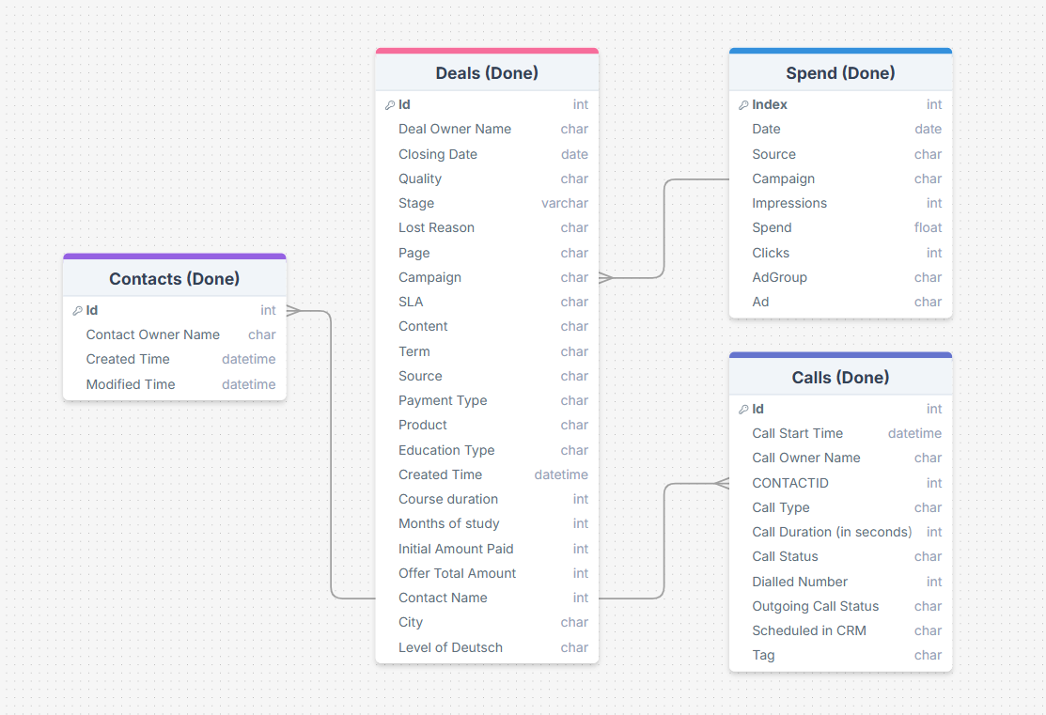
Tables
Interaction diagram between the tables
Final Project | DrawSQL
Notes:
Реализовала графическое представление 4 исходных таблиц и возможность их взаимодействия между собой

Slide 8
Python part

Slide 9
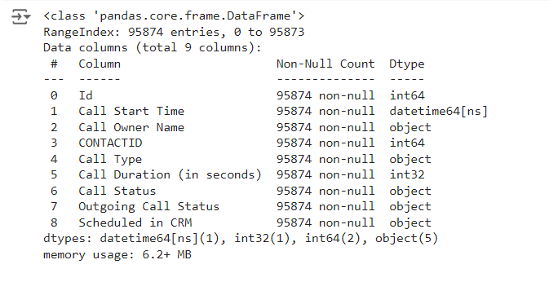
Calls
Transformations of the Calls Table:
Missing values filled in.
Data types changed.
Columns removed.
The Scheduled in CRM column transformed from boolean values to yes, no, unknown.
Colab

Slide 10
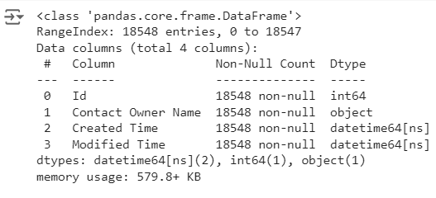
Contacts
Transformations of the Contacts Table:
Data types changed.
None missing.
Colab

Slide 11
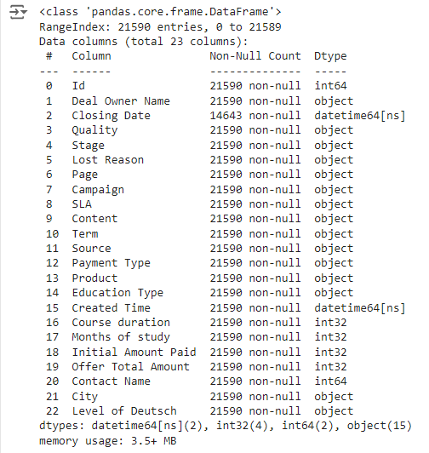
Deals
Transformations of the Deals Table:
Missing values filled in.
Data types changed.
The content of the Level of Deutsch column transformed into 8 possible values.
Colab

Slide 12
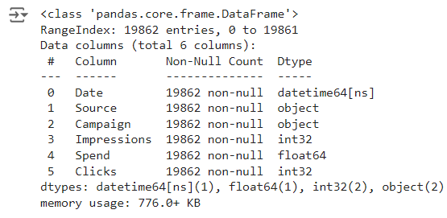
Spend
Transformations of the Spend Table:
Missing values filled in.
Data types changed.
Unused columns removed.
Colab

Slide 13
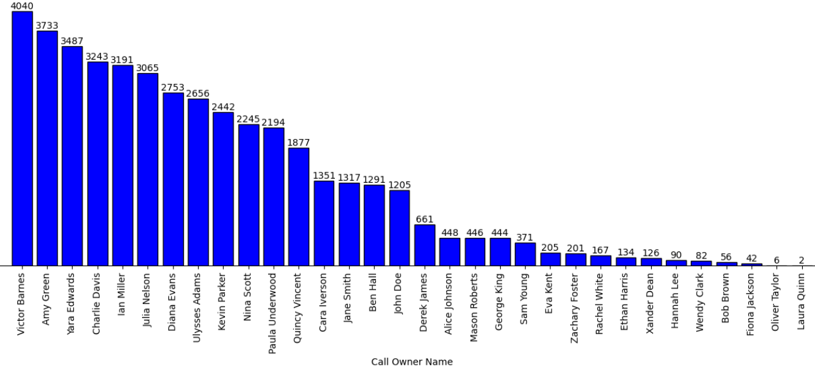
Сalls by manager
Absolute Leader: Victor Barnes
Many managers do not have a large number of calls.
Colab

Slide 14
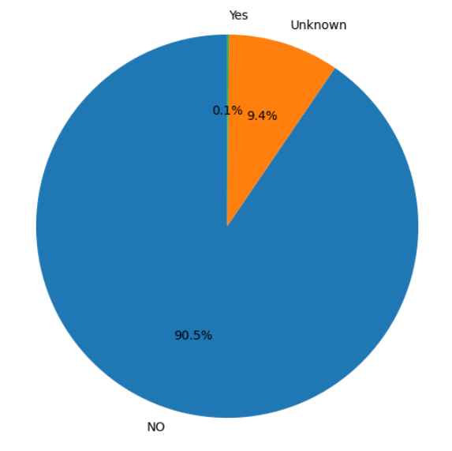
Scheduled in CRM calls
The number of calls scheduled in the CRM system is low.
This functionality is not in demand.
Colab

Slide 15
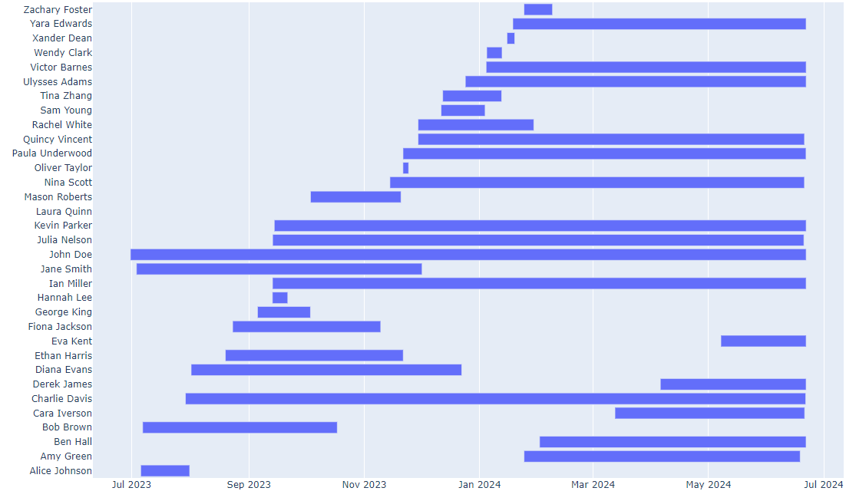
Manager work periods
High employee turnover.
John Doe has been working since the beginning, but his performance is not the highest.
Colab

Slide 16
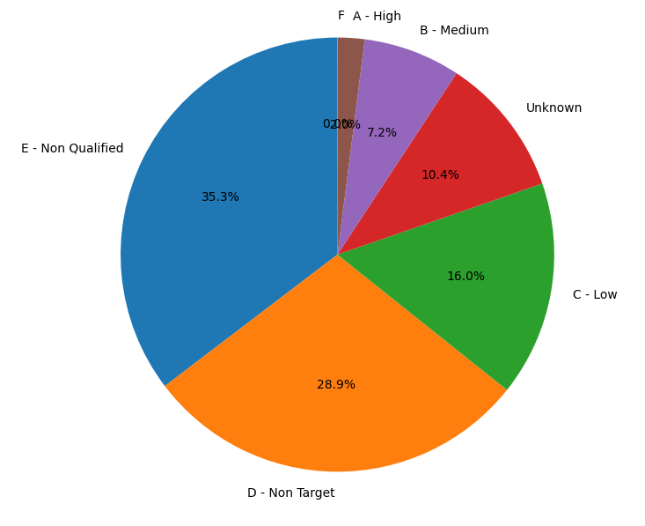
Distribution of quality for all deals
The quality of deals is mostly below average.
Colab

Slide 17
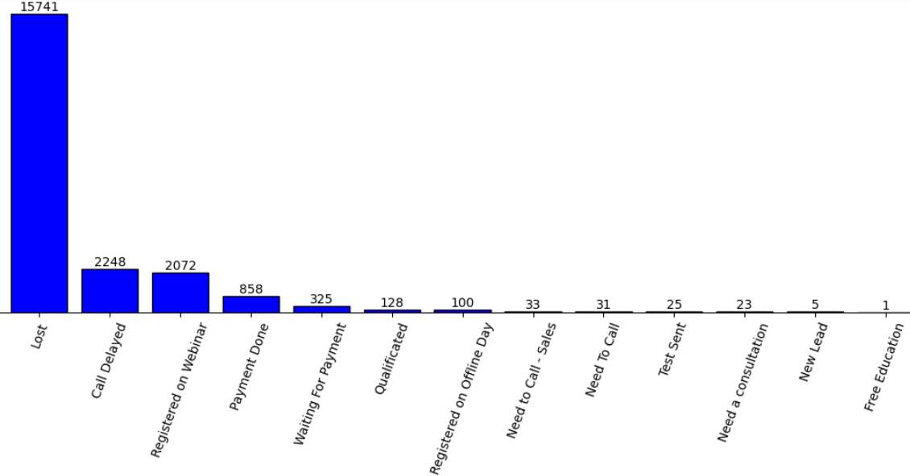
Deals by status
A large number of lost potential clients.
Colab

Slide 18
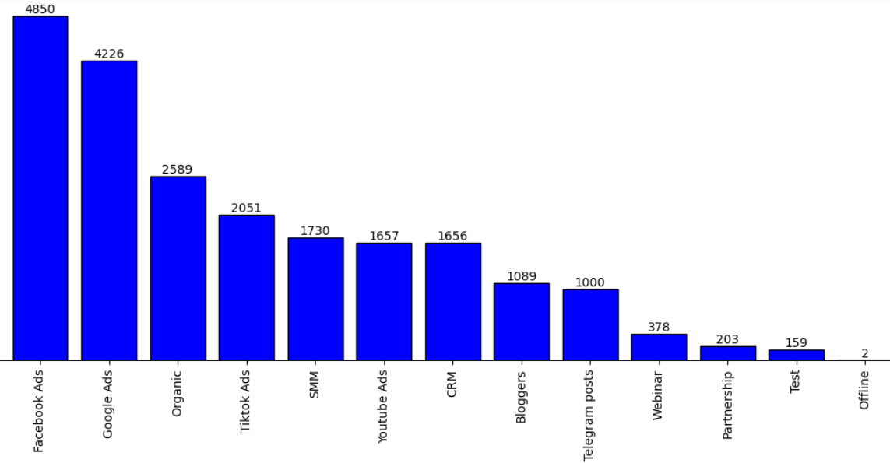
Distribution by source
Facebook, Google, and Organic are the sources generating the most potential clients.
Colab

Slide 19
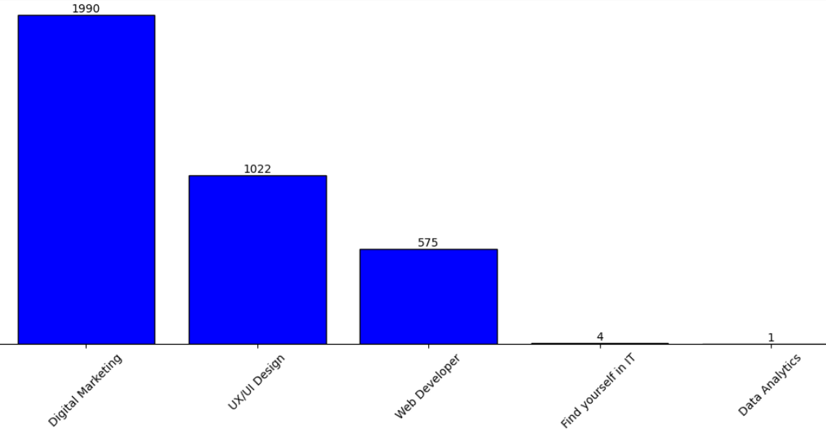
Deals by product
The Digital Marketing course is a leader.
The Data Analytics course is not in demand.
Colab

Slide 20
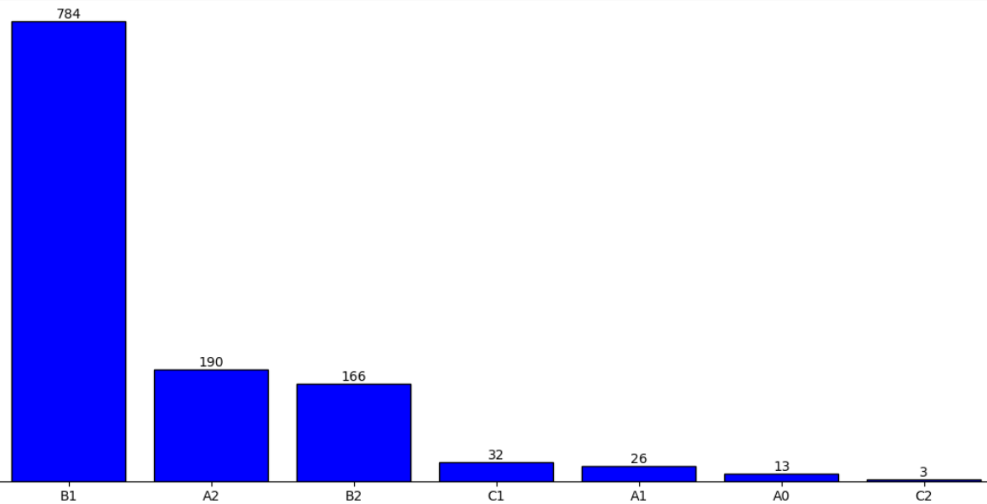
Deals by Level of Deutsch
The average level of German language proficiency predominates.
Colab

Slide 21
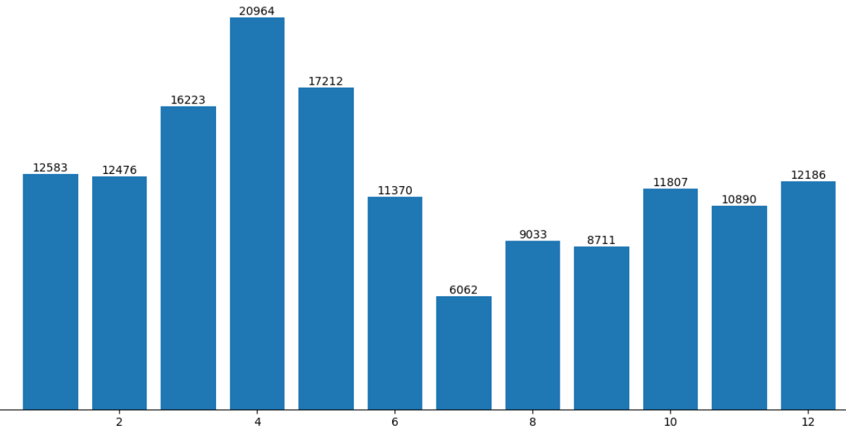
Amount of spends by months
Since the beginning of operations, spending on marketing has increased.
Since April, expenses have decreased, which may have led to a drop in contracts in May-June.
Colab

Slide 22
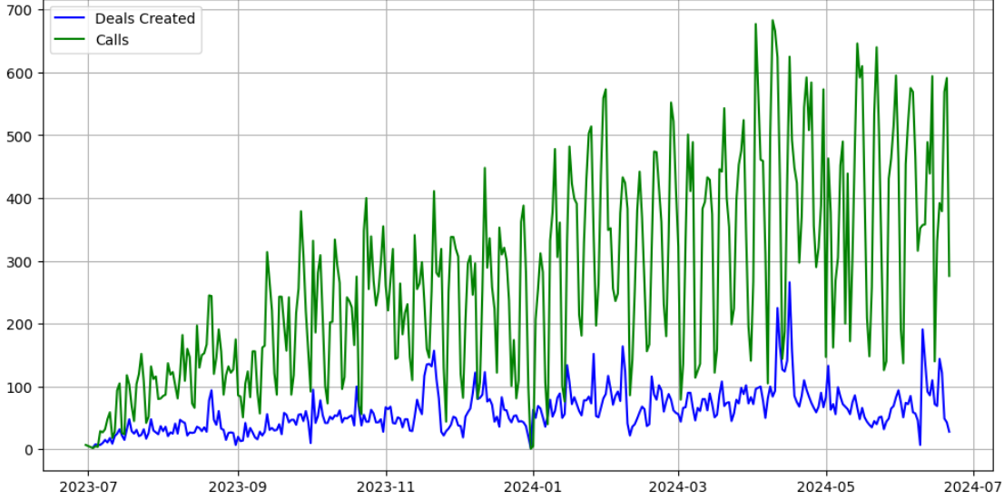
Comparison of Deals and Calls
There is a correlation between calls and deals, but there is occasionally a slight delay.
Colab

Slide 23
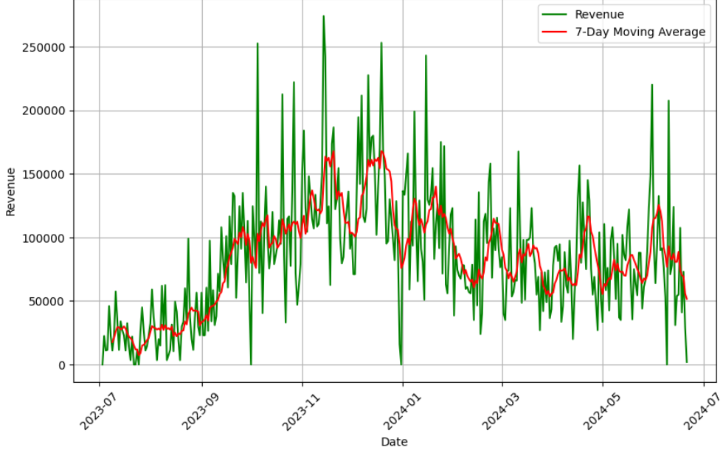
Revenue with 7-Day Moving Average
The trend is gradually decreasing and stabilizing.
The peak was in December of last year.
The possible decline is related to partial restrictions on government funding.
Colab

Slide 24
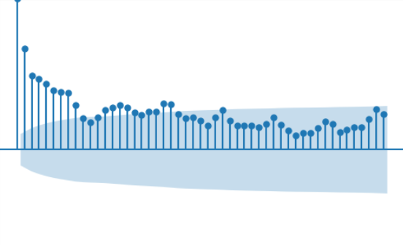
Autocorrelation function
Very predictable: the closer to the current moment, the more accurate the forecast.
Colab

Slide 25
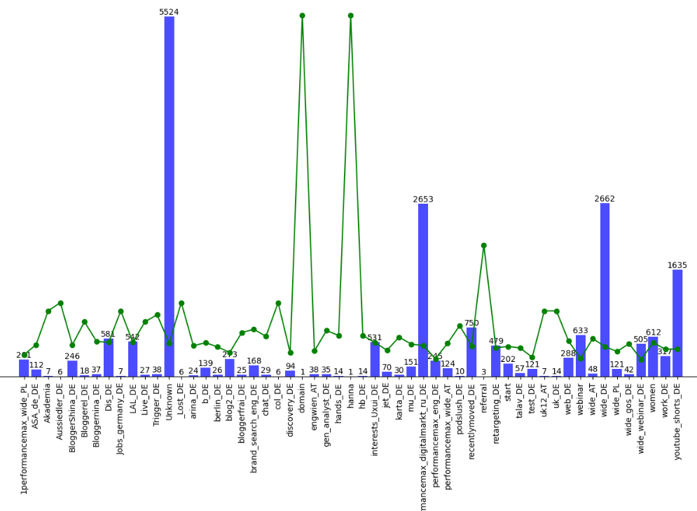
Total Leads and Conversion Rate by Campaign
Marketing campaigns - digital marketing, wide, youtube_shorts have the best overall performance.
Colab

Slide 26
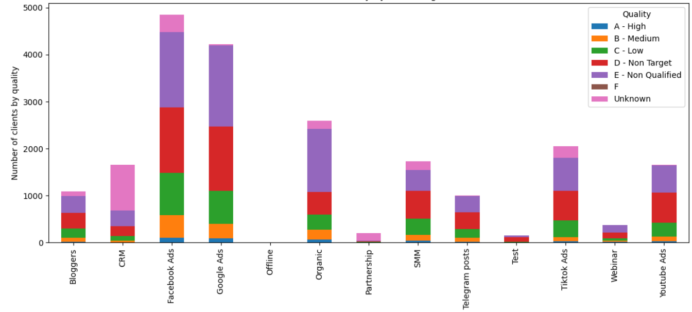
Distribution of Quality by Marketing Source
The highest quality deals come from clients sourced from Facebook, Google, and Organic sources.
Colab

Slide 27
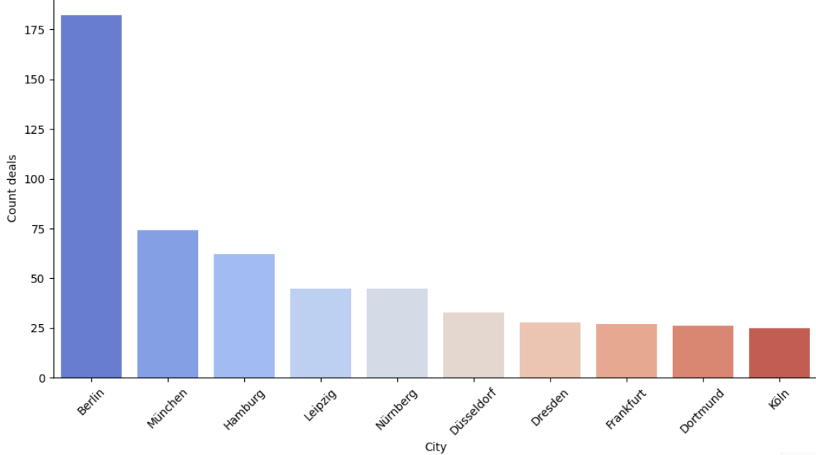
Deals by city
Berlin is the record holder for the number of users who reached out.
Colab

Slide 28
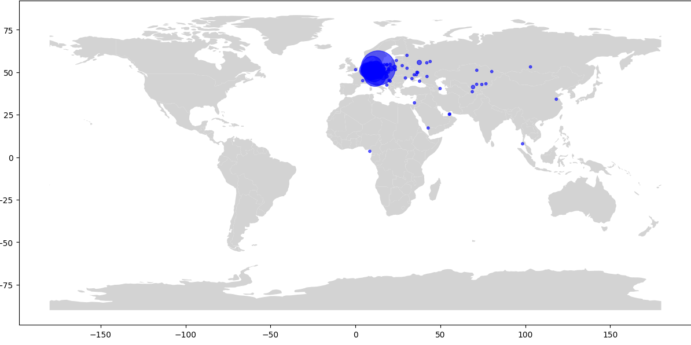
Deals by city on map
Most of our users are located in Western Europe. There are occasional instances in Eastern Europe, the Asian part of the continent, Africa, and Oceania.
Colab

Slide 29
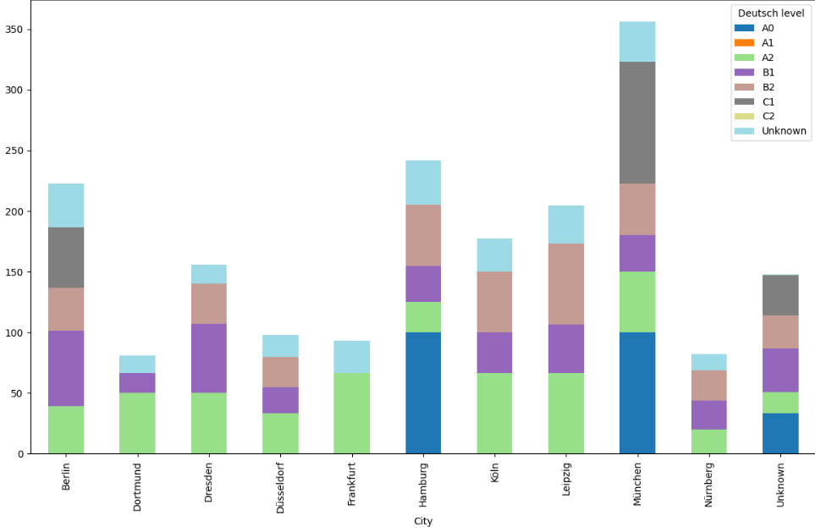
Successful deals by city and Deutsch level
over 20 deals in the city
In Berlin and Munich, many individuals who reached out to the school do not know German.
In the overall picture, a larger number of people have an average level.
Colab

Slide 30
Product analysis

Slide 31
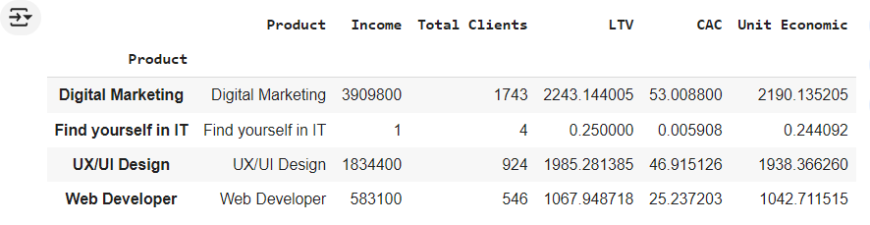
Unit economic per product
Digital Marketing generates the highest profit.
The average revenue generated by one client broken down by products shows that the most profitable products are Digital Marketing and UX/UI Design.
Good performance across all products except for Find Yourself in IT.
According to these values, one can say that the user generates significantly more revenue than the company spends on attracting them.
Data reflecting GOGS, i.e., cost of goods sold, is missing.
Colab
Notes:
Доход в разбивке по продуктам, из этой таблицы видно, что наибольшую прибыль приносит Digital Marketing
Здесь можно увидеть средний доход, который приносит один клиент в разбивке по продуктам, из этой таблицы видно, что наиболее выгодные продукты
- Digital Marketing и UX/UI Design
Хорошие показатели по всем продуктам, кроме Find yourself in IT, но весьма допустимо, что после данного курса клиент возьмет другой курс.
По данным значениям можно сказать что пользователь приносит намного больше дохода, чем компания затрачивает на его привлечение, с учетом того что скорей
всего клиент не будет возвращаться вторично в компанию за другими курсами/услугами, но может сработать реферально.
Если компания будет продолжать привлекать клиентов с такими же показателями, то при прочих равных будет зарабатывать столько же на клиента.

Slide 32
Unit economic per client
The cost of acquiring one client reflects our advertising expenses and shows how much we spend to attract one user.
Average revenue from one paying client.
The marketing effectiveness indicator is quite high, indicating a high return on every dollar spent.
Data reflecting GOGS, i.e., cost of goods sold, is missing.
The unit economics indicator is very high, meaning the business generates significant profit for each acquired client.
Colab
Notes:
стоимость привлечения одного клиента отображает наши издержки на рекламу и показывает сколько средств мы тратим на привлечение одного пользователя,
даже того кто не остался с нами.
Средний доход с одного платящего клиента, с учетом что клиент не вернется повторно
Показатель маркетинговой эффективности достаточно высок, и это хорошо. Свидетельствует о высоком доходе на каждый потраченный доллар.
Но также прошу учитывать что у меня данных по расходам GOGS, тоесть себестоимость.
Показатель юнит экономики очень высок, что говорит о том, что бизнес приносит значительную прибыль на каждого привлечённого клиента.

Slide 33
Identify growth points
Indicators of income from clients and marketing costs are very good; they will be somewhat lower if we subtract the cost of goods sold. But currently, the figures are sufficiently high. At this time, I do not see growth opportunities in marketing.
A potential growth opportunity may lie in the implementation of another course. Here, we need to take a closer look at users who are interested in courses but could not find the course they wanted, such as a Project Management course or an Automated Testing course.
Another potential growth opportunity could be in creating courses in German/English. My assumption is based on the fact that there are currently many Russian-speaking clients due to emigration. However, it is possible that demand will decline over time. Therefore, to expand the market niche, this could be a good growth point.
Based on conversion data, I currently consider sales to be the most optimal growth point. The conversion to paid deals is 9.38 (calculated based on unique deal IDs).
Notes:
Из юнит-экономики определить точки роста бизнеса
Основываясь на юнит экономике, той которая у меня есть, показатели дохода от клиентов и затрат маркетинга, очень хорошие, в действительности они конечно не настолько хорошие, потому что себестоимости мы не знаем. Но сейчас они очень высокие. Поэтому я не вижу точки роста в маркетинге на текущий момент.
Возможная точка роста может быть во внедрении еще одного курса, здесь нужно более глубоко посмотреть на тех пользователей, которые заинтересованы в курсах, но не нашли интересующий их курс, например курс проектного менеджера или автоматизированного тестирования.
Также возможная точка роста может быть в создании курсов на немецком/английском языке. По причине физического нахождения в Германии этот шаг в конечном итоге нужно будет сделать. Мое предположение строится на том факте, что рускоязычных клиентов в настоящее время достаточно много по причине миграции большого количества рускоязычного населения, и вопрос освоения новой профессии в настоящее время актуален. Но возможно с течением времени спрос будет падать. Поэтому чтоб расширить нишу на рынке это может быть хорошей точной роста.
Основываясь на данных конверсии, на текущий момент наиболее оптимальной точкой роста я считаю продажи. Конверсия в оплаченные сделки 9.38 (считала по уникальным Id сделки)

Slide 34
Metric tree
Revenues:
Number of deals
Average check (how much one client spends on average)
Margin for each product
Clients:
Number of new clients
Conversion
Average number of clients per manager
Average call duration
Customer lifecycle duration (from the moment a client is created in the database until payment)
Marketing:
Marketing expenses
CAC - cost of acquiring one client
Number of clicks
Market reach through advertising

Slide 35
Hypotheses
1. Conducting a marathon will provide potential users with an introduction to the subject. This will help reduce client churn (after the start of training) by 20%. The hypothesis will affect metrics such as:
Revenues:
Number of deals
Average check (how much one client spends on average)
Margin for each product/Total revenue
Clients:
Number of new clients
Conversion of marathon participants to course participants/overall conversion
Retention rate of marathon participants
Customer lifecycle duration
Marketing:
Marketing expenses
CAC - cost of acquiring one client
Number of leads collected during the marathon
Marketing ROI for the marathon
NPS (Net Promoter Score) after the marathon.

Slide 36
Hypotheses
2. After passing the test on the website, send the user the test answers, their result, and recommendations. This will help combat the user's internal insecurity about their ability to successfully complete the course, which will increase the conversion to paying clients by 5%.
The hypothesis will affect metrics such as:
Revenues:
Number of deals
Average check (how much one client spends on average)
Clients:
Number of new clients
Conversion of participants who received test results to payment
Conversion of participants who did not receive test results to payment
Customer lifecycle duration
Marketing:
Marketing expenses
CAC - cost of acquiring one client
Number of clicks
Reach and number of tests taken

Slide 37
Hypotheses
3. Expanding localizations (English, German) of the courses will allow attracting not only Russian-speaking audiences. This will increase the attraction of new clients by 30%.
The hypothesis will affect metrics such as:
Revenues:
Number of deals
Average check (how much one client spends on average)
Margin for each product and localization
Clients:
Number of new clients by localization
Conversion by localization
Average number of clients per manager
Marketing:
Marketing expenses by localization
CAC - cost of acquiring one client by localization
Number of clicks/visits by localization
Market reach by localization
Return on investment by localization

Slide 38
Hypotheses
4. Collaboration with government organizations (Jobcenter, BIZ (Berufsinformationszentrum)). Placing advertising information (posters, brochures) will increase interest and attract new potential clients by 15%.
The hypothesis will affect metrics such as:
Revenues:
Number of deals
Average check (how much one client spends on average)
Clients:
Number of new clients attracted through government organizations
Conversion of attracted clients
Customer lifecycle duration
Marketing:
Marketing expenses (advertising materials)
CAC - cost of acquiring one client through government organizations
Number of transitions via QR code, for example
Market reach through advertising

Slide 39
Hypotheses
5. Revising the motivation for the sales department staff. Implementing a percentage of the deal as a bonus for sales staff. The bonus program for the sales department will increase deal closure efficiency by 40%.
The hypothesis will affect metrics such as:
Revenues:
Number of deals
Average check (how much one client spends on average)
Revenue per manager
Clients:
Conversion per manager
Average number of clients per manager
Number of successful deals per manager
Marketing:
CAC - cost of acquiring one client

Slide 40
Hypotheses
6. Introducing additional motivation for sales department staff. Asking clients to evaluate the manager's performance or leave feedback. Aggregating data and rewarding the top performers monthly. This will increase conversion by 10%. The hypothesis will affect metrics such as:
Revenues:
Number of successful deals
Average check (how much one client spends on average)
Clients:
Number of new clients
Conversion during calls with managers
Average number of clients per manager
Average call duration
Customer lifecycle duration
Marketing:
CAC - cost of acquiring one client
Customer satisfaction level, evaluation of manager performance
Ratings and reviews for each manager
Average rating of the sales department’s performance

Slide 41
Hypotheses
7. Expanding the range of courses offered at the school. Introducing another popular and in-demand course will increase client attraction by 20% and allow for scaling.
The hypothesis will affect metrics such as:
Revenues:
Number of deals
Average check (how much one client spends on average)
Revenue from the new course
Clients:
Number of new clients
Conversion for the new course
Customer lifecycle duration
Marketing:
Marketing expenses for the new course
CAC - cost of acquiring one client
Market reach through advertising for the new course
Popularity of the new course compared to others
NPS for the new course

Slide 42
Hypotheses
8. Revising the sales department's staff. Analyzing the sales department's performance and optimizing staff through training and terminating ineffective employees will reduce costs by 10%.
The hypothesis will affect metrics such as:
Revenues:
Number of deals
Average check (how much one client spends on average)
Revenue per manager
Clients:
Conversion during calls
Average number of clients per manager
Marketing:
Effectiveness of each manager before and after staff reduction
Employee satisfaction level after optimization

Slide 43
Hypothesis testing method
I will describe the testing of the second hypothesis, as it most fully meets the testing requirements: a duration of 2 weeks and the possibility of conducting an A/B test.
Hypothesis breakdown:
Idea: After completing the test on the website, send the user the test answers, their result, and recommendations. This will help combat the user's internal insecurity about their competence and their ability to successfully complete/pass the course.
Success metric: Increase in conversion to course payment (defined as the percentage of users who paid for the course).
Target conversion: +5% to the current conversion rate.
Defining groups for testing:
Group A (control group): Users who take the test but do not receive results or recommendations.
Group B (test group): Users who receive test results and personalized recommendations (e.g., based on their test answers).

Slide 44
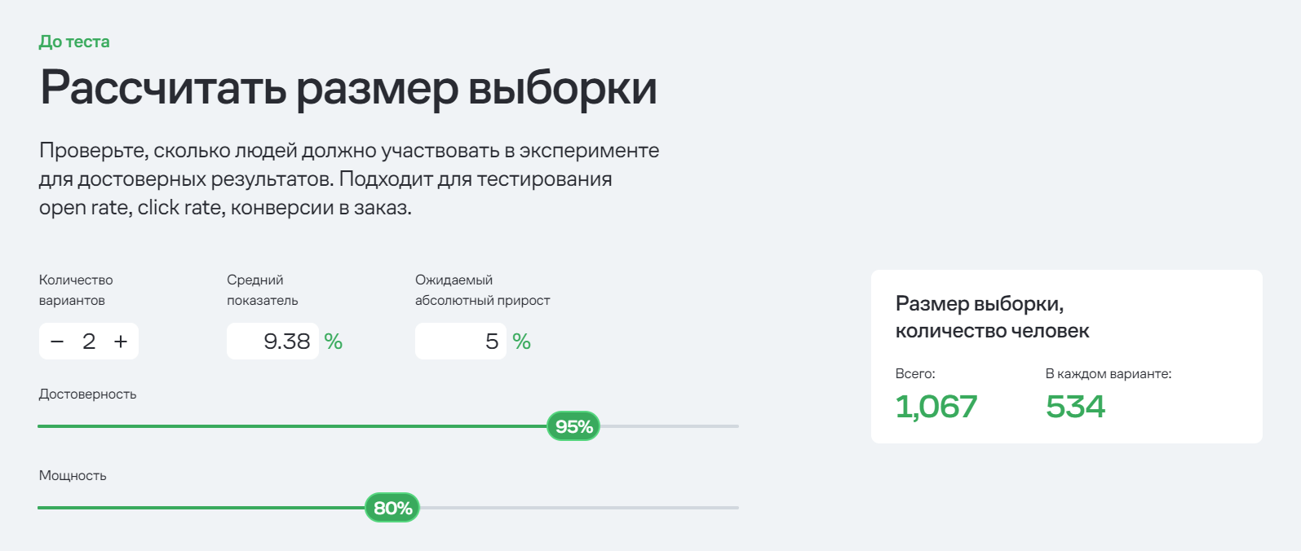
Hypothesis testing method
Criteria for conducting the test:
Sample size: To calculate the sample size, I will use the Mindbox calculator.

Slide 45
Hypothesis testing method
Duration: 2 weeks, according to the requirements. I do not know the current traffic numbers, but it seems to me that this is a realistic figure for gathering the necessary traffic in 2 weeks. Since the decision to take courses and choose a school is significant, a person does not make it instantaneously; typically, a person contemplates this decision, and it requires time. We can calculate the change in conversion immediately after the test is conducted among users who participated in the testing and recalculate every two weeks for one to one and a half months.
Traffic: Both groups (A and B) should receive 534 users each, without resorting to additional conditions/samples (browser used, device, age) to avoid biasing the data in either direction.
Expected results:
If the hypothesis is correct, the conversion to course payment in the test group should be 5% higher than in the control group (current rate of 9.38).
Data Collection and Analysis:
I propose using analytical systems (e.g., Google Analytics) to track conversions for each group. I will also monitor other potential metrics that may influence the outcome: Bounce rate, Engagement, and Retention rate.

Slide 46
Hypothesis testing method
Decision Making:
Positive Outcome: If the test group shows a significant improvement in conversion by the expected 5% or more, the hypothesis is confirmed, and the strategy can be scaled to all users.
Negative Outcome: If there are no changes or they are insignificant (e.g., less than 5% or if conversion even decreases), the hypothesis is rejected, and the proposed strategy needs to be revised.
Post-Test Actions:
If the hypothesis is confirmed, sending results and test recommendations can be implemented for all users as a permanent process. In the case of a negative outcome, additional analysis can be conducted to identify improvements or test other hypotheses (e.g., modifying the format or content of recommendations).
Example of Segmentation and Analysis: Additionally, users can be segmented by device type (mobile/desktop), geographic location, and other parameters to identify where changes are most effective.

Slide 47
Difficulties
Challenges Encountered: Typically, challenges arose from a lack of clear understanding of the data and a large number of inconsistencies in statuses/data with logical conclusions.
To improve data collection and data quality, the following can be implemented:
Request the country of residence, not just the city, as there are cities with the same name in different countries.
Implement city selection via a dropdown list or display matches as characters are typed, followed by selection. This will lead to consistency in the database content. City names can be written in several languages, which introduces its own complexities.
The selection of the level of German language can also be implemented via a dropdown list if further analysis of the column is anticipated.
A large number of statuses do not correspond to reality or have disputable moments. For example, the absence of a payment amount in the status "payment completed" and vice versa, where the payment amount is present but the status is different.
Responsible managers in the contact and call tables are different with the same client ID.

